Slide 1







MaokAI
Mass Distributed Coaching

Slide 2


Product description
AI Program
Core Product
AI Coach
Live Assistance Tool
Improvement Tool
Concrete Product
Futuristic Technology
Advanced Features
Extended Product

Slide 3

Value Propositions
AI Coach
UVP
All-In-One LoL Improvement app
FPV

Slide 4







Competitor Analysis
In-depth Situational Analysis
MaokAI
Mobalytics
Low Time Commitment
High Time Commitment
Blitz
U.GG
Porofessor
Basic Statistical Analysis

Slide 5







Feature Comparison
Blitz
Moba
Free
Prem
Prem+
Price
$4.99
$4.99
$0
$2.99
$7.99
AD-free
Advanced Builds
Basic Overlays
Simple Match Report
Player Scouting
Matchup Advice
Combos
Post-Game AI Coach
1 Game / Day
Unlimited
Unlimited
Mid-Game AI Coach
Communicating With AI Coach
AI-Powered Pro-Analysis
AI-Powered Meta-Analysis
All-In-One League Of Legends App

Slide 6




Market Potential
Total Playerbase
2023: 152 Million
Total Target Audience
96% * 152 Million = 146 Million
Esports CAGR
Statista.com = 7.1%

Slide 7

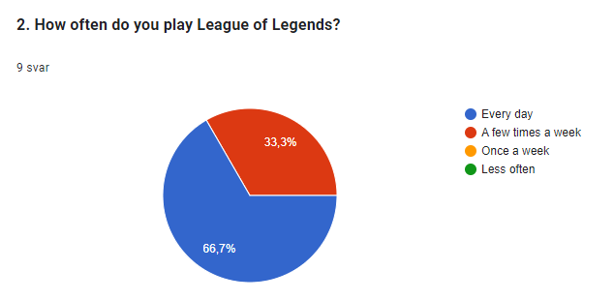
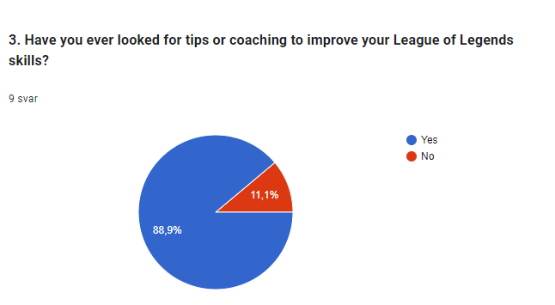
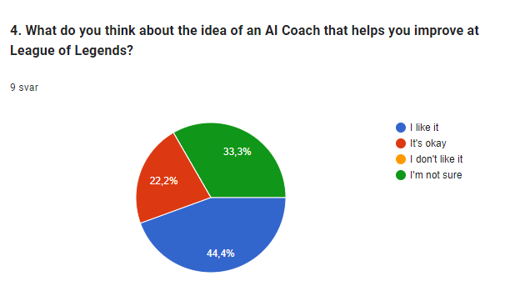
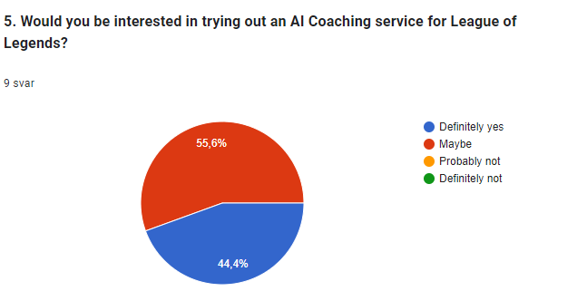
Consumer Survey

Slide 8








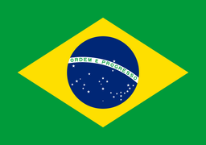


Market Analysis - Target Segments
Europe
Psychological Profile
Asia
Massive Market Potential
Tertiary

Slide 9








Promotion - Streamers
Greatest Of All-Time
Ex-Pro
Analytical Streamers
Large Streamer
Ex-Pro
Pro
Large Streamer
Large Content Creator

Slide 10

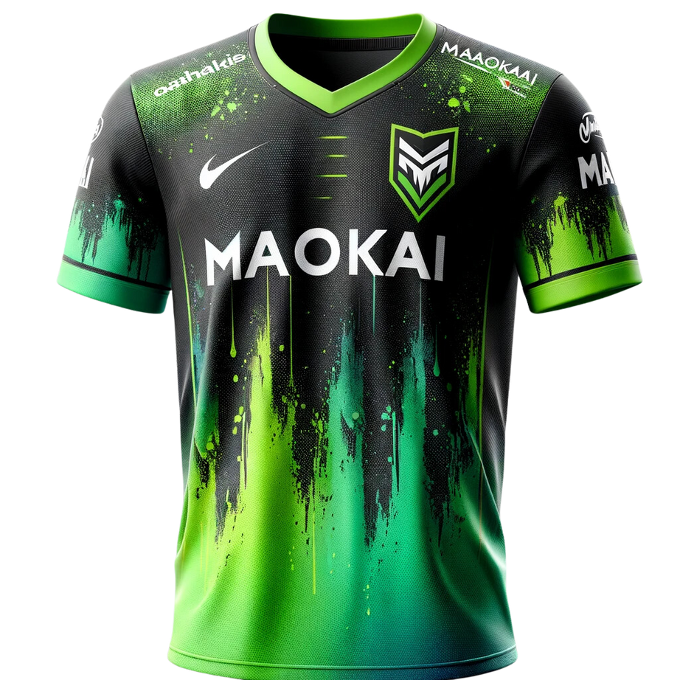
Promotion - Jersey

Slide 11






Promotion - Internet presence
Live updates
Long Form
Content
Short-form content
Chinese
Audience
Advertisment
Our Website:
Maok.ai

Slide 12

Timeline - Key Events
Have Working Prototype
Start Beta Development
Grow Userbase
Sustaine Losses
Pay Back Debt
Start Developing FPV
Launch FPV
2024 April
2024 May
2024 July
2025 July
2026 Q1
2026 End
2027
Launch First Product
Start Promotion & Advertisment
Expand AI Training Rate & Developer Team
Start Prototype Creation
Turn Profit
Improve FPV

Slide 13

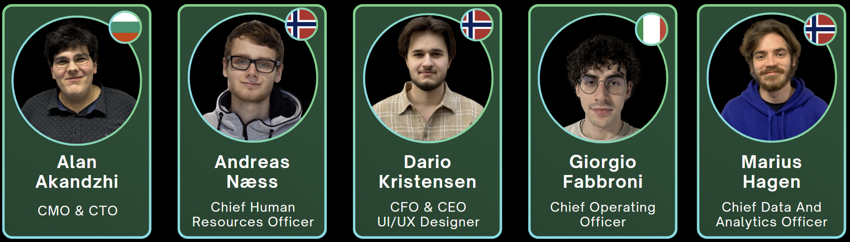
Our team

Slide 14
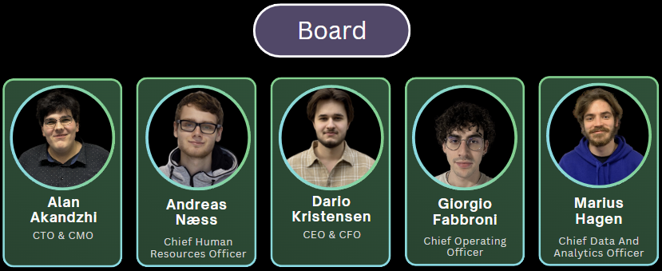
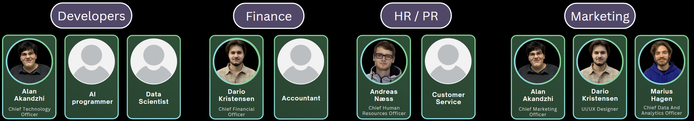
Our organization

Slide 15




Future partner prospects
Systran
Smartling
AI language models
MemoQ

Slide 16

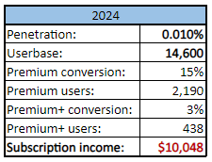
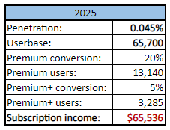
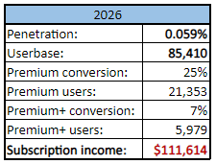
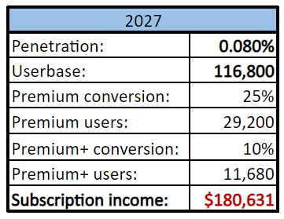
Revenue Streams
Mobalytics
Worth: $13.9 M
Monthly revenue: $700 K
Main income source: Subscriptions

Slide 17
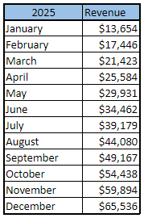
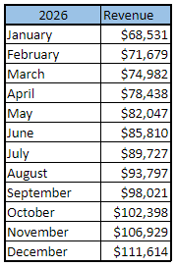
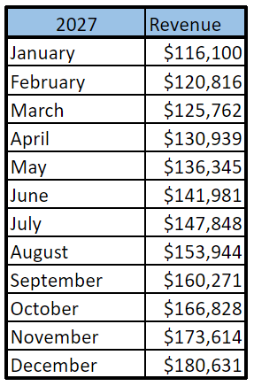
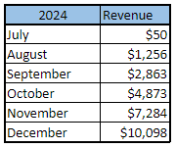
Revenue Streams
Mobalytics
Worth: $13.9 M
Monthly revenue: $700 K
Main income source: Subscriptions

Slide 18

Early Costs (in USD)
Item
Prototype
Pre-Launch
AI Programmer
2.2 K
4.5 K
Data scientist
2.7 K
5.4 K
Website
-
50
Server Storage (Google Cloud)
4.5 K
9 K
AI Training and Predictions (Vertex AI)
10.8 K
21.6 K
Unplanned costs (10%)
2 K
4 K
Total costs
22.2 K
44.4 K

Slide 19


Budget (in USD)
2024
2025
2026
2027
Income
Subcriptions
26.4 K
454.8 K
1.06 M
1.76 M
Advertisments
-
5 K
40 K
100 K
Total Income
26.4 K
459.8 K
1.1 M
1.88 M
Costs
AI Programmer
22.7 K
27 K
54 K
54 K
Data Scientist
21.6 K
25 K
25 K
25 K
Website
175
1 K
2 K
5 K
AI Training & Predictions
145.8 K
194.4 K
291.6 K
437.4 K
Servers Storage
60.8 K
81 K
121.5 K
182.3 K
Advertisments
15 K
30 K
40 K
50 K
Sponsorships
12 K
20 K
30 K
50 K
Office
-
-
100 K
33 K
Unplanned Costs (10%)
20.9 K
37.8 K
66.4 K
83.7 K
Total Costs
305.8 K
416.2 K
730.5 K
920.3 K
Net Revenue
-279.4 K
43.6 K
373.5 K
934.8 K

Slide 20

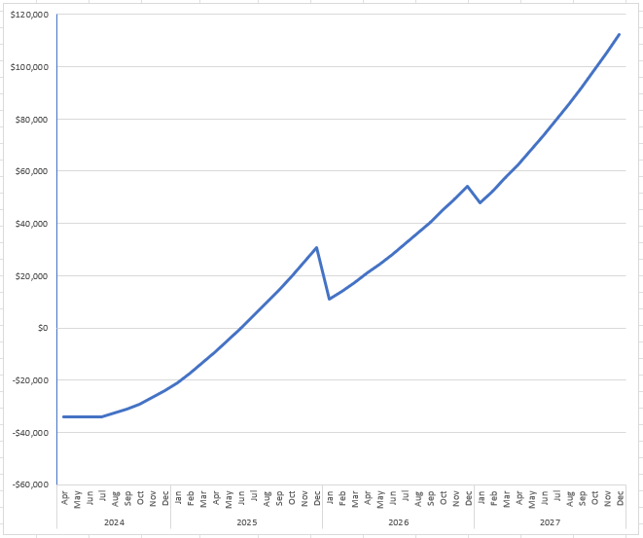
Revenue Graph
Est. Profits: $1.32M
Est. Startup Cost: $351K

Slide 21







Pre-Money Valuation
2024
2025
Raised: $2.5M
Comparison Facts
Target
Range
Factor
Size Of Opportunity
170%
20%
34%
Strength Of Team
55%
13%
7%
Value: $12.3M
Raised: $1.4M
Product & Technology
120%
20%
24%
Sales/Market/Partnership
50%
12%
6%
Competitive Environment
120%
10%
12%
Value: $11.2M
Raised: $2.5M
Need For Additional Investment
30%
20%
6%
Other Factors
100%
5%
5%
SUM
96%
Value: $13.9M
Value:
96% * $1M = $960K

Slide 22



Funding plan (in USD)
April 2025
April 2024
May 2024
Sep-Oct 2024
April 2024
May 2024
Sep-Oct 2024
Pre-Seed
Round
Seed
Round
Series A
Round
(22.2K)
(150-200K)
(130-190K)
Private Funding
Equity Funding
Equity Funding
22.2K
1% = 9.6K
10-15% = 100-150K
1% = ~10.3K
7-10% = 75-130K
Private Funding
Private Funding
40K
20K
Business Loan
Business Loan
20-30K
30K

Slide 23





Risk mitigation
Riot License
Finances
Competitors
Data Security
Riot API & TOS
Early Funding & Startup Cost
Easy To Replicate
Storing Of Login Information

Slide 24




Ethical dilemmas
01
Cheating
02
Removing Jobs
03
Server Pollution

Slide 25

SWOT
Analysis
Strengths
Market-knowledge
Innovative thinking
S
W
Weaknesses
Opportunities
Lack of programming skills
Lack of app development skills
No prior experience
Existing market, modified idea
AI-development
O
T
Threats
Funding
Riot license

Slide 26







Conclusion
Key points
League of Legends AI tool
All in one app
Marketing
Massive market
Target Asia
Organization
Need developers
Financials
High startup cost
High potential

Slide 27




THANK
YOU
Maok.AI
+12 34 56 78 90
MaokAI@mail.com
Jon Lilletuns vei 9, 4879 Grimstad

Slide 28
IMAGE SOURCES
Slide 4:
Porofessor.gg - APK Download for Android. (n.d.). Porofessor-Gg.en.aptoide.com. Retrieved March 25, 2024, from https://porofessor-gg.en.aptoide.com/app
Blitz Press – Medium. (n.d.). Medium. Retrieved March 25, 2024, from https://medium.com/blitz-press
U.GG - Desktop App for Mac, Windows (PC), Linux. (n.d.). WebCatalog. Retrieved March 25, 2024, from https://webcatalog.io/en/apps/u-gg/
Install Mobalytics on Ubuntu using the Snap Store. (n.d.). Snapcraft. Retrieved March 25, 2024, from https://snapcraft.io/install/mobalytics-desktop/ubuntu
Slide 5:
Blitz Press – Medium. (n.d.). Medium. Retrieved March 25, 2024, from https://medium.com/blitz-press
Install Mobalytics on Ubuntu using the Snap Store. (n.d.). Snapcraft. Retrieved March 25, 2024, from https://snapcraft.io/install/mobalytics-desktop/ubuntu
Slide 8:
Wikipedia Contributors. (2019a, March 28). Flag of Brazil. Wikipedia; Wikimedia Foundation. https://en.wikipedia.org/wiki/Flag_of_Brazil
Fil:Flag of Australia.svg – Wikipedia. (2007, April 16). Commons.wikimedia.org. https://no.m.wikipedia.org/wiki/Fil:Flag_of_Australia.svg
Fil:Flag of the People’s Republic of China.svg – Wikipedia. (2021). Wikipedia.org. https://nn.m.wikipedia.org/wiki/Fil:Flag_of_the_People%27s_Republic_of_China.svg
File:Flag of Europe.svg - Wikipedia. (n.d.). Commons.wikimedia.org. Retrieved March 25, 2024, from https://en.m.wikipedia.org/wiki/File:Flag_of_Europe.svg
Smith, W. (2019). Flag of Korea, South. In Encyclopædia Britannica. https://www.britannica.com/topic/flag-of-South-Korea
Leepson, M. (2019). Flag of the United States of America. In Encyclopædia Britannica. https://www.britannica.com/topic/flag-of-the-United-States-of-America
Slide 9:
Baiano. (n.d.). Leaguepedia | League of Legends Esports Wiki. Retrieved March 25, 2024, from https://lol.fandom.com/wiki/Baiano
Broxah. (n.d.). Leaguepedia | League of Legends Esports Wiki. Retrieved March 25, 2024, from https://lol.fandom.com/wiki/Broxah
Caedrel. (n.d.). Leaguepedia | League of Legends Esports Wiki. https://lol.fandom.com/wiki/Caedrel
Doublelift. (n.d.). Leaguepedia | League of Legends Esports Wiki. https://lol.fandom.com/wiki/Doublelift
Faker. (n.d.). Leaguepedia | League of Legends Esports Wiki. https://lol.fandom.com/wiki/Faker
Uzi (Jian Zi-Hao). (n.d.). Leaguepedia | League of Legends Esports Wiki. Retrieved March 25, 2024, from https://lol.fandom.com/wiki/Uzi_(Jian_Zi-Hao)
Midbeast. (n.d.). Leaguepedia | League of Legends Esports Wiki. Retrieved March 25, 2024, from https://lol.fandom.com/wiki/Midbeast
CheonGo. (n.d.). Leaguepedia | League of Legends Esports Wiki. Retrieved March 25, 2024, from https://lol.fandom.com/wiki/CheonGo
Wikipedia Contributors. (2019a, March 28). Flag of Brazil. Wikipedia; Wikimedia Foundation. https://en.wikipedia.org/wiki/Flag_of_Brazil
Fil:Flag of Australia.svg – Wikipedia. (2007, April 16). Commons.wikimedia.org. https://no.m.wikipedia.org/wiki/Fil:Flag_of_Australia.svg
Fil:Flag of the People’s Republic of China.svg – Wikipedia. (2021). Wikipedia.org. https://nn.m.wikipedia.org/wiki/Fil:Flag_of_the_People%27s_Republic_of_China.svg
File:Flag of Europe.svg - Wikipedia. (n.d.). Commons.wikimedia.org. Retrieved March 25, 2024, from https://en.m.wikipedia.org/wiki/File:Flag_of_Europe.svg
Smith, W. (2019). Flag of Korea, South. In Encyclopædia Britannica. https://www.britannica.com/topic/flag-of-South-Korea
Leepson, M. (2019). Flag of the United States of America. In Encyclopædia Britannica. https://www.britannica.com/topic/flag-of-the-United-States-of-America
Slide 11:
Download TikTok logo on transparent background. (n.d.). Vecteezy. https://www.vecteezy.com/vector-art/6057996-tiktok-logo-on-transparent-background
Freer, A. (2023, July 31). X officially launches its Ads Revenue Sharing platform for content creators. Business of Apps. https://www.businessofapps.com/news/x-officially-launches-its-ads-revenue-sharing-platform-for-content-creators/
Wikipedia Contributors. (2018, December 13). Instagram. Wikipedia; Wikimedia Foundation. https://en.wikipedia.org/wiki/Instagram
Youtube Logo bilder – Bla gjennom 22,614 arkivbilder, vektorer og videoer. (n.d.). Adobe Stock. Retrieved March 25, 2024, from https://stock.adobe.com/no/search?k=youtube+logo
Weibo. (2023, November 11). Wikipedia. https://en.wikipedia.org/wiki/Weibo
Slide 13:
Wikipedia Contributors. (2019b, December 30). Flag of Bulgaria. Wikipedia; Wikimedia Foundation. https://en.wikipedia.org/wiki/Flag_of_Bulgaria
Wikipedia Contributors. (2018, December 11). Flag of Italy. Wikipedia; Wikimedia Foundation. https://en.wikipedia.org/wiki/Flag_of_Italy
Wikipedia Contributors. (2019, February 6). Flag of Norway. Wikipedia; Wikimedia Foundation. https://en.wikipedia.org/wiki/Flag_of_Norway
Slide 15:
Memoq logo - Hungary | Branding design logo, Go logo, ? logo. (n.d.). Pinterest. Retrieved March 25, 2024, from https://in.pinterest.com/pin/memoq-logo-hungary--846817536168174164/
Smartling Logo PNG Vector (SVG) Free Download. (n.d.). Seeklogo. Retrieved March 25, 2024, from https://seeklogo.com/vector-logo/339936/smartling
Why developers like Systran. (n.d.). StackShare. Retrieved March 25, 2024, from https://stackshare.io/systran
Slide 16 & 17:
Install Mobalytics on Ubuntu using the Snap Store. (n.d.). Snapcraft. Retrieved March 25, 2024, from https://snapcraft.io/install/mobalytics-desktop/ubuntu
Slide 21:
Bellwethr | LinkedIn. (2021, January 17). Www.linkedin.com. https://www.linkedin.com/company/bellwethr
Datatron Pricing, Features, and Reviews (Mar 2024). (n.d.). Www.softwaresuggest.com. Retrieved March 25, 2024, from https://www.softwaresuggest.com/datatron
Startupxplore. (n.d.). Gestoos profile at Startupxplore. Startupxplore. Retrieved March 25, 2024, from https://startupxplore.com/en/startups/gestoos
Install Mobalytics on Ubuntu using the Snap Store. (n.d.). Snapcraft. Retrieved March 25, 2024, from https://snapcraft.io/install/mobalytics-desktop/ubuntu
Slide 23:
RİOT LOGO. (n.d.). Pinterest. Retrieved March 25, 2024, from https://www.pinterest.jp/pin/356769601745191082/

